Slide 1

Retail Challenge
Data Scientist – Laura Le

Slide 2
Business Context
About Business: UK-based unique gift supplier with over 1 million transactions (2009-2011).
Challenge:
Forecast sales & identify targeted marketing segments.
Manage high business volume during peak seasons (Oct-Dec).
Goal:
Enhance profitability; reduce returns & cancellations.
Approach:
Data-driven customer segmentation.
Time-series sales forecasting.
Key Takeaway: Leveraging insights to maximize profitable sales and minimize disruptions during peak seasons.
Notes:
Today, I'll present insights drawn from a dataset provided to me about a notable UK-based gift company. This company, offering a unique array of all-occasion gifts, has seen a massive volume of over a million transactions within just a two-year span, from 2009 to 2011.
Let's break down our primary objectives:
Sales Forecasting: We aim to harness the power of this data to predict sales, with a keen focus on the UK's holiday season – the peak from October to December.
Strategic Customer Segmentation: We're on a mission to identify not just who our customers are, but which ones offer the highest value. The objective is clear: Target those who buy consistently and have a lower tendency to return products.
Why does this matter? Accurate sales forecasting can streamline operations, from inventory management to marketing efforts, driving profit margins up. Concurrently, a deep dive into customer behavior provides invaluable insights, ensuring we resonate with our target audience, fostering loyalty and engagement.
Using the dataset at hand, I've gleaned patterns, predictions, and actionable insights. Let's embark on this journey together and uncover the potential strategies hidden in the data!"

Slide 3
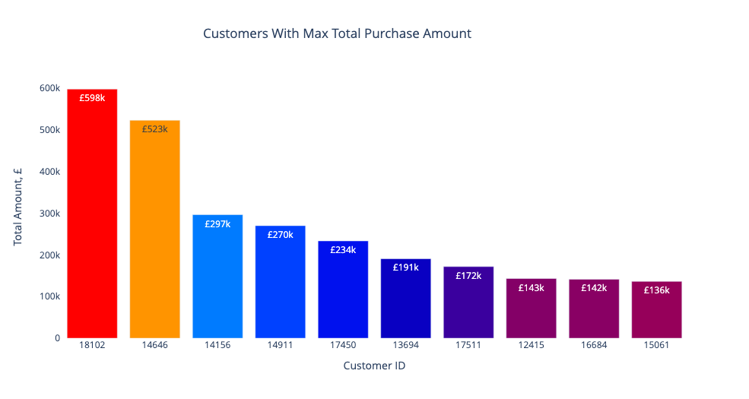
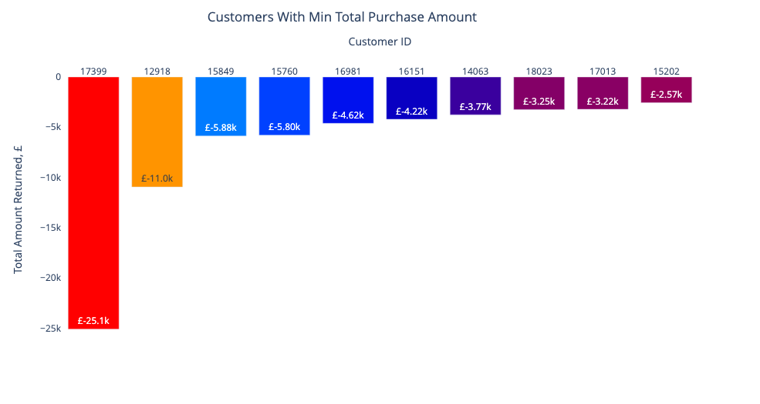
Customer Analysis: Total Purchase Amount
Sales Highlights:
- Highest spender: ID 18102 (UK) at £598k.
- Next: Netherlands customer at £523k.
- Top 10 mainly from UK, EIRE, Netherlands, Australia.
- Largest return: UK customer with £25k.
- Key observation: Top spenders and returners come from similar countries.
Notes:
Take a look at total purchase amount by Customer, we turn our attention to our highest spenders, the spotlight is on Customer 18102 from the United Kingdom, who has lavishly contributed £598k over two years. Not too far behind, we have a patron from the Netherlands ringing up a bill of £523k. Collectively, our top 10 spender list is dominated by customers from the UK, EIRE, Netherlands, and Australia - representing strong economies.
Interestingly, when we glance at the opposite spectrum, where customers have spent the least, the figures turn negative, hinting at returns. The highest return value is a substantial £25k, and what's intriguing is that this customer also hails from the UK. It's worth noting that most of the significant return amounts originate from the same countries as our top spenders. A unique dynamic worth exploring further."

Slide 4
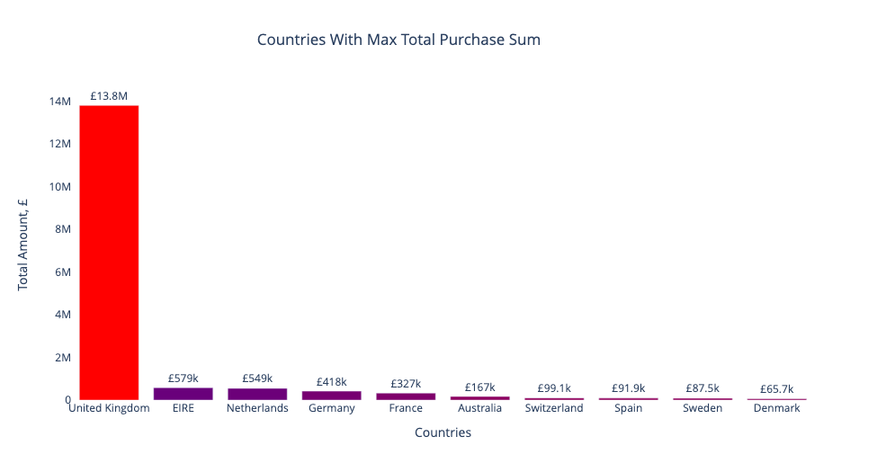
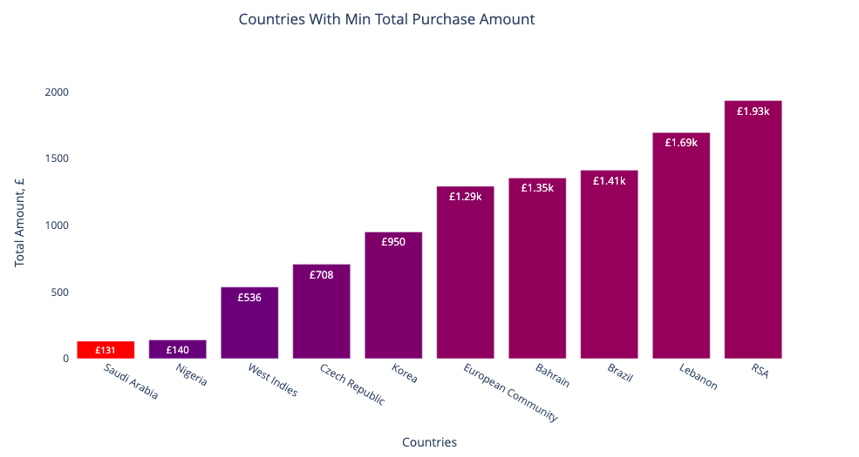
Country Analysis: Total Purchase Amount
Sales Highlights:
- UK leads with £13.8M in purchases.
- EIRE follows at £579k, 23x less!
- Top ten countries all in Europe.
- Lowest spender: Saudi Arabia (£131 in 2 years).
- Notable exception in Europe: Czech Republic.
Notes:
Let's delve into the total purchase amount by country. Dominating the charts, we have the United Kingdom, showcasing a whopping £13.8M in purchases. In comparison, EIRE, our next highest contributor, stands at £579k, which is a staggering 23 times less! A fascinating observation is that our top ten spenders are all nestled within Europe.
On the flip side, Saudi Arabia has the distinction of being our smallest spender, with a modest £131 over two years. While it's typical for countries with lower spending to be outside Europe, there's an intriguing outlier: the Czech Republic. With more comprehensive data, I'd be eager to explore the story behind this."

Slide 5
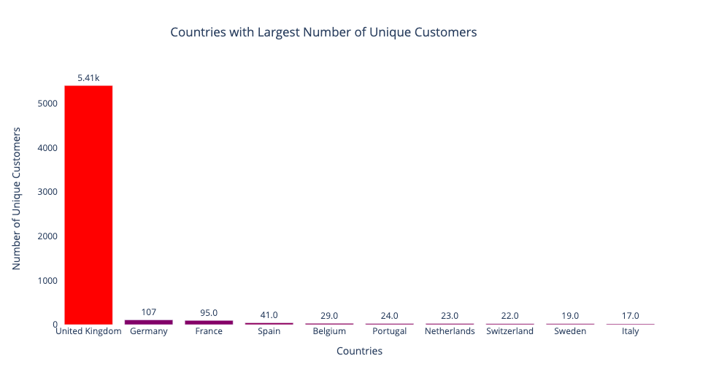
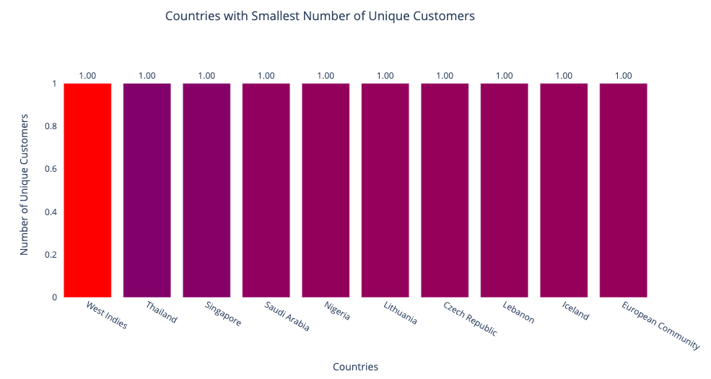
Country Analysis: Unique Customers
Customer insights:
- UK dominates with 5.41k.
- Germany and France come next with 107 and 95 respectively.
- Several countries, including Thailand and Nigeria, have only one customer.
- Single-buyer anomalies in Europe: Czech Republic, Lithuania, European Community.
Notes:
Turning our attention to unique customer by country, the UK stands out remarkably with a staggering 5.41k individual customers making purchases in the last two years. To put this into perspective, Germany and France, while significant players, have only 107 and 95 unique customers respectively. This vast gap echoes trends we identified during our purchase analysis.
Now, diving deeper, we find something interesting. A variety of countries, from Thailand to Nigeria, and even Saudi Arabia, have just one solitary customer recorded. What's more intriguing is that alongside these, we also see European regions like the Czech Republic, Lithuania, and the European Community each having only one unique customer. One might wonder about smaller regions like Iceland, but what's the story behind these European numbers? It's a fascinating point to consider.

Slide 6
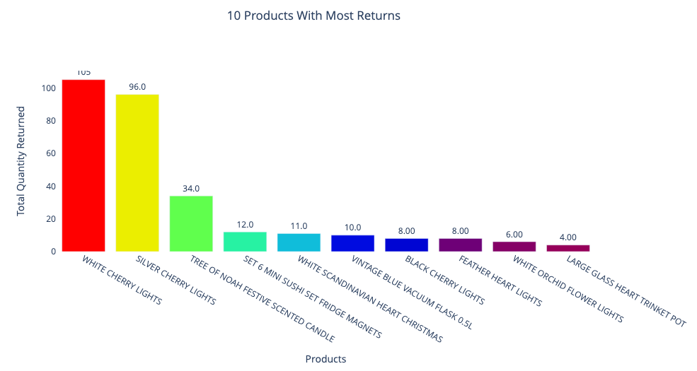
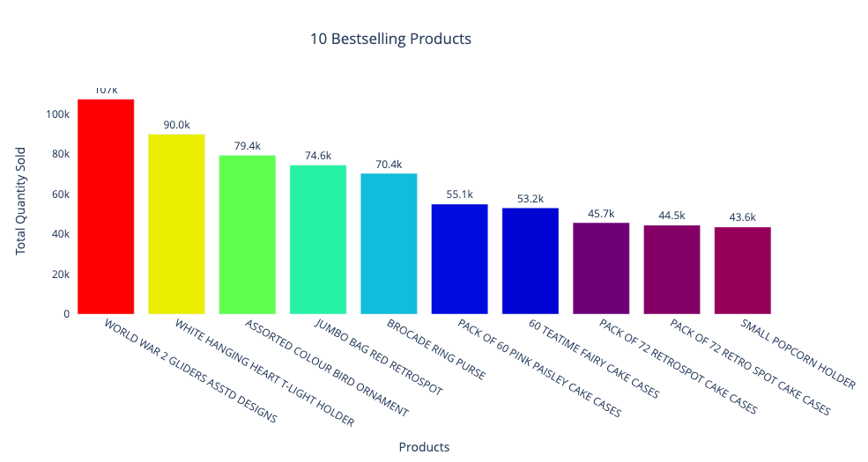
Product Analysis: Quantity
Product Quantity Analysis:
Bestseller: World War II Gliders (107k in 2 years).
Top 10 includes: Holders, cake cases, a purse, and jumbo bag.
Most Returns: White Cherry Lights (105 returns in 2 years).
Return List Dominance: Decor items and gifts - candles, flasks, pots, magnets, and lights.
Notes:
Let’s diving into our product insights. The standout performer is World War II Gliders, with a staggering 107,000 units sold in just two years. Our assortment doesn't just cater to enthusiasts; everyday items like cake cases, holders, purses, and jumbo bags are also amongst our bestsellers. However, on the topic of returns, there's a trend we should be aware of. Our White Cherry Lights lead this category with 105 units returned. Interestingly, a number of decorative items such as candles, flasks, and magnets also appear frequently. This may signal areas we need to revisit for quality or market positioning.

Slide 7
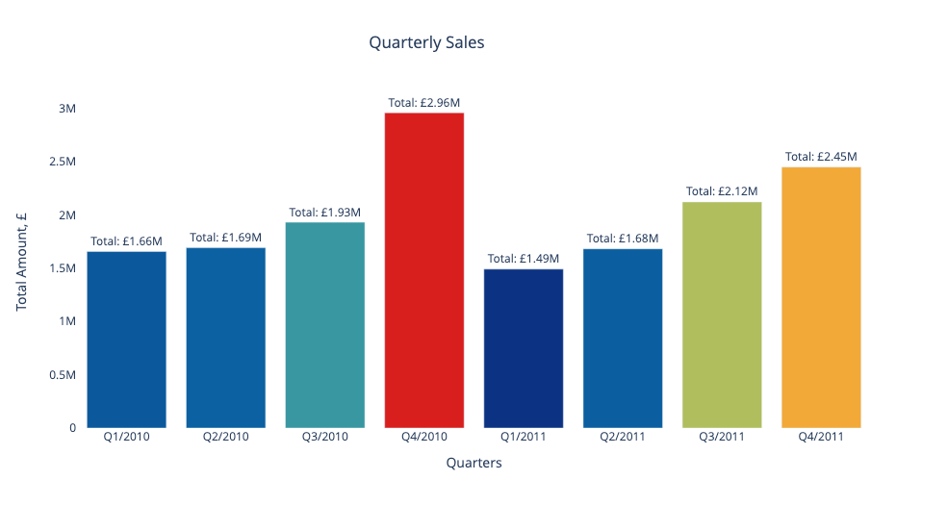
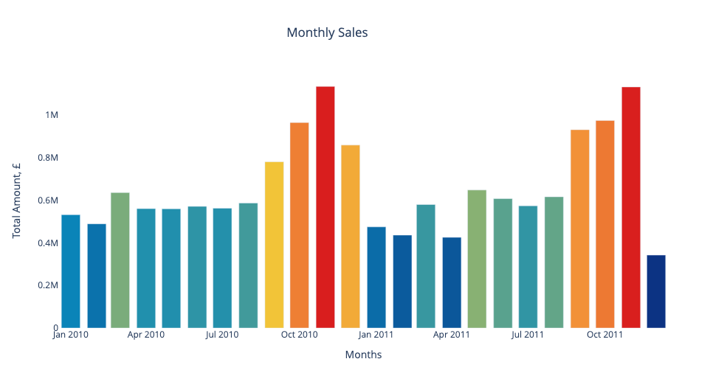
Online Sales Timeline
Sales Trend Insights:
- Seasonal spikes evident, particularly pre-Christmas.
- Post-holiday dip observed.
- Significant decline: December 2011 sales just half of December 2010's.
Notes:
Looking at our data, the seasonal trends are clear. We see a surge in purchases leading up to Christmas, followed by a noticeable decline. When we zoom in, these holiday spikes become even more pronounced. But here's something interesting: December 2011's sales were just half of what we saw in December 2010. A dramatic decrease year-over-year.

Slide 8
Data Preprocessing Steps
Data cleaning: Keep rows with price > 0, remove duplicated records
1
Handling missing values: drop 22% of the rows have a missing value for the Customer ID
2
Feature Engineer: calculate total value of each transaction:
Total = price * quantity.
3

Slide 9
RFM analysis
Segment customers based on their purchase patterns by grouping them based on their previous purchase transactions, with 3 quantitative factors:
Recency: How recently a customer has made a purchase
Frequency: How often a customer makes a purchase
Monetary: How much money a customer spends on purchases

Slide 10
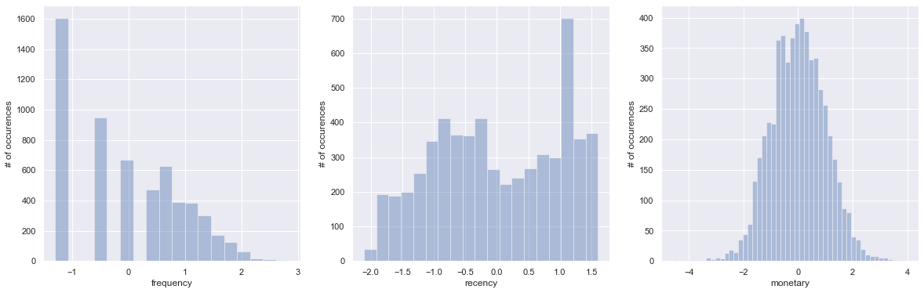
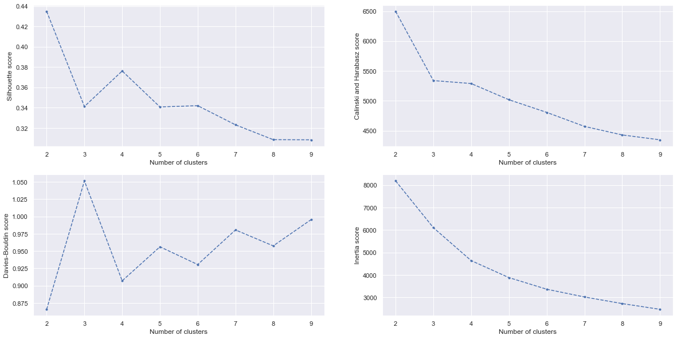
K-means Clustering
- Standardize the variables to get symmetric distribution.
- The plots from different metrics all suggest that the best number of clusters is 4
- K-means compute and assign the clusters for each customer.

Slide 11
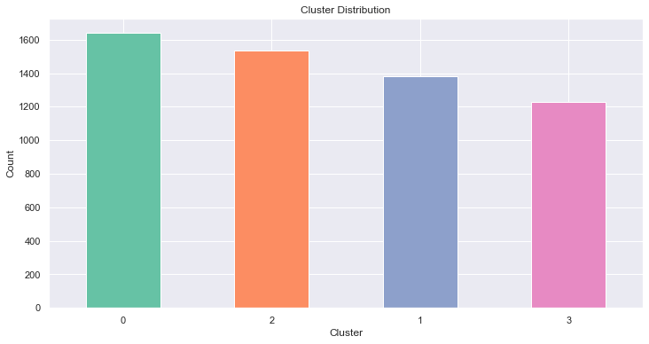
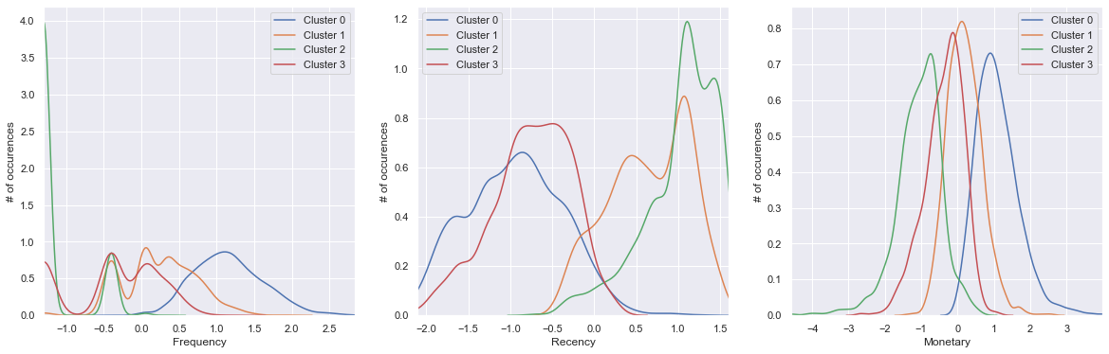
Customer Cluster Analysis
Cluster 0 - Loyal Customers:
- Largest group, highest spenders, frequent transaction
- Last transaction: 34 days ago.
- Action: Consider rewarding with free shipping.
Cluster 2 - High Value, Less Frequent:
- High spenders but infrequent visits.
- Potential to migrate them to regular customers.
- Action: Engage with new deals and product suggestions.
Cluster 3 - Occasional Shoppers:
- Moderate spending, less frequent orders.
- Last purchase: few months back.
- Profile: Intermittent shoppers.
Cluster 1 - Inactive Customers:
- Minimal spending, long absence since last purchase.
- Likely churned.
- Action: Re-engagement strategies needed.
Notes:
About the clusters identified, Starting with Cluster 0, this is our gold standard. It boasts the majority of our customer base, who are not only high spenders but also frequent shoppers, making their most recent purchase just over a month ago. This is our core customer base, and considering their loyalty, introducing benefits like free shipping could enhance their shopping experience even further.
Next, we have Cluster 2. These folks are significant spenders but haven't visited us recently. This is an opportune moment to re-engage them with fresh product launches or exclusive deals. Our aim? To transition them to regulars like our Cluster 0.
Then there's Cluster 3, a segment of occasional shoppers. They're moderate spenders, and their shopping patterns are more sporadic, with their last visit being a few months back. They represent our casual shoppers who may pop in now and then.
Lastly, Cluster 1. Here, we have a challenge. They've shown minimal engagement, both in terms of spending and frequency. It's been a considerable time since their last purchase, indicating they might have moved away from our platform. Crafting a unique re-engagement strategy is essential for this group."

Slide 12
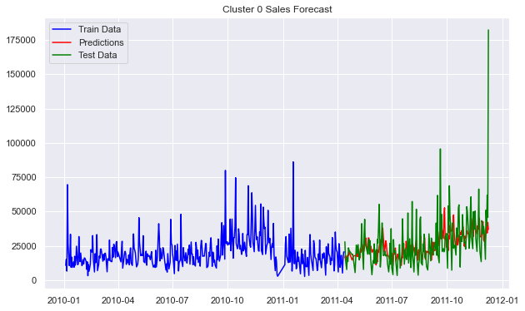
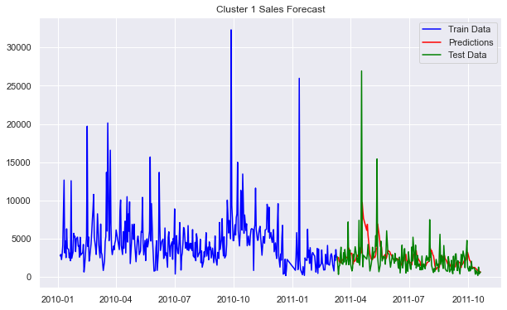
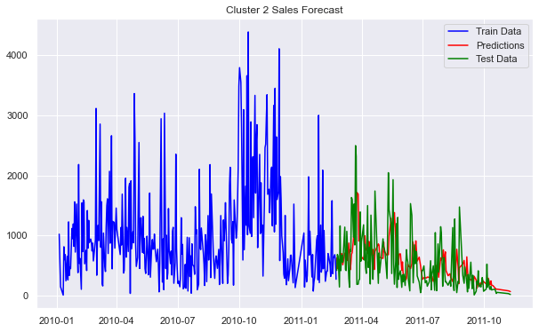
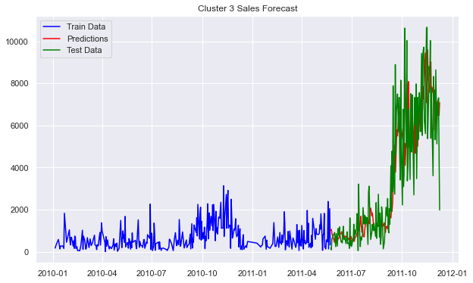
Train & Evaluate the Model
- Create daily sales data for each cluster
- Split train and test sets
- Use ARIMA to fit and forecast sales
- Use MSE to evaluate the performance of models for each cluster

Slide 13
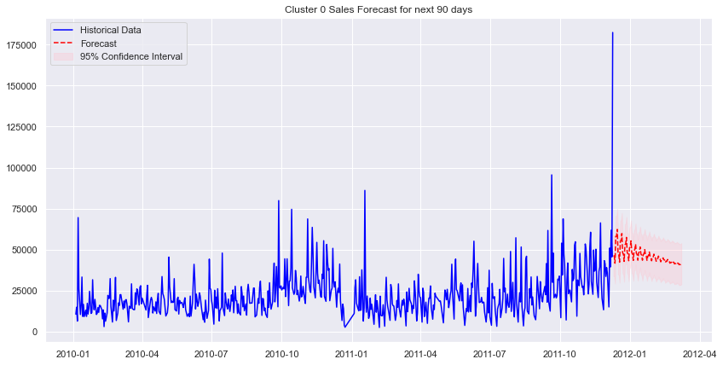
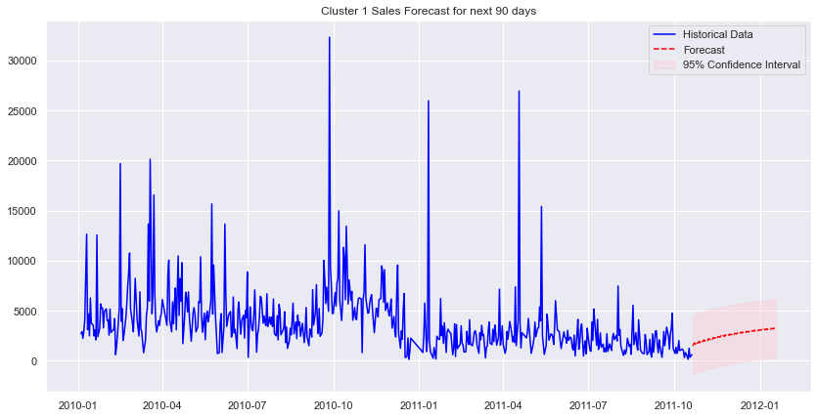
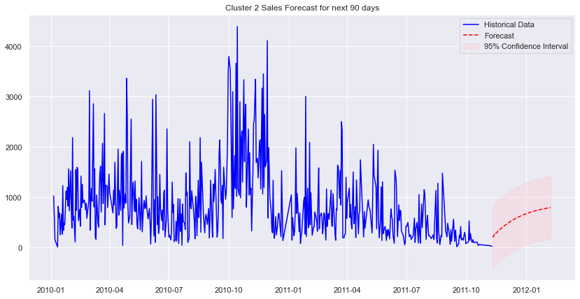
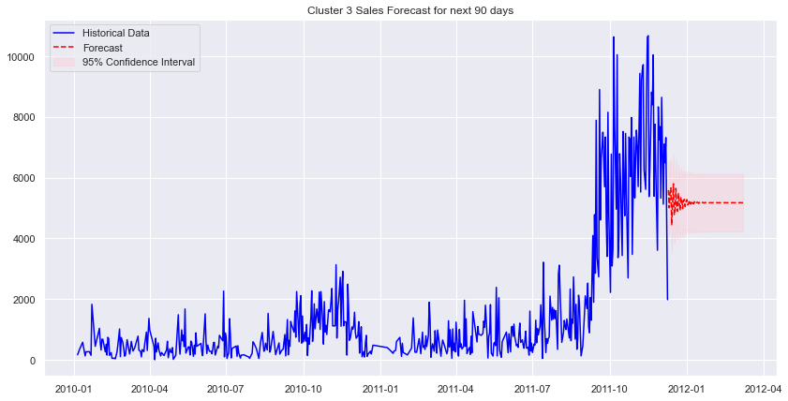
Forecast Sales in next 30 days
Sales Forecast Summary:
The sales forecasted drop from 2011-12-10 to 2012-03-08 across all clusters could be attributed to post-holiday effects, inventory shortages, or shifts in market conditions.
- Cluster 0: Expecting a decrease in sales, then stabilizing towards the end.
- Cluster 1: Slight decline in sales is forecasted.
- Cluster 2: Steady drop anticipated over the period.
- Cluster 3: Initial stability followed by a slight decrease in sales.

Slide 14
Difficulties in the challenge
- Data Complexity: With over a million transactions between 2009 and 2011, handling and processing the data proved challenging.
- Seasonality Impact: The high business volume during the UK's peak holiday seasons (October to December) made it difficult to distinguish between seasonal spikes and consistent sales patterns.
- Cancellations & Returns: Identifying loyal customers amid frequent bulk order returns and cancellations proved intricate due to the wholesale business nature.
- Forecasting for Clusters: Diverse purchasing behaviors in each cluster required specialized forecasting, complicating predictions due to factors like seasonality and return rates.
Notes:
I would like to share about key challenges I faced during analyzing the customer data to uncover insights and forecast sales:
First, the Data Complexity. We were working with over a million transactions spanning from 2009 to 2011. The vast amount of data presented hurdles in both handling and processing.
Then, we had the Seasonality Impact. As you know, the UK experiences a surge in business volume, especially during the peak holiday seasons from October to December. This surge often blurs the lines, making it challenging to differentiate between genuine sales growth and mere seasonal spikes.
Another significant challenge was related to Cancellations & Returns. Given the company's wholesale business nature, identifying truly loyal customers amid frequent bulk order returns and cancellations was quite intricate.
And lastly, Forecasting for Clusters. Each customer cluster exhibited unique purchasing behaviors. This diversity meant that I had to customize the forecasting approaches for each cluster, adding another layer of complexity. Factors like seasonality and varying return rates further complicated the forecasting process.

Slide 15
Future Analysis Recommendation
1. Deepening Customer Insights
- Dive deeper into individual customer behaviors within segments.
- Explore psychographic attributes, like motivations and preferences, to further refine segments.
2. Enhancing Forecasting Techniques
- Incorporate advanced machine learning models beyond ARIMA, such as LSTM or Prophet, for improved accuracy.
- Test ensemble techniques by blending multiple forecast models.
3. Expanding Feature Engineering
- Develop new features based on purchasing behaviors, such as preferred product categories, or seasonality preferences.
- Evaluate the impact of external factors, like marketing campaigns or economic trends, on sales.
4. RMF & Kmeans Optimization
- Re-evaluate cluster stability over time and adjust Kmeans parameters.
- Explore alternative segmentation methods like hierarchical clustering or DBSCAN to ensure optimal segmentation.
5. Impact of Strategy on Sales
- Post-implementation review of strategies to determine real-world effectiveness.
- Assess the correlation between forecasted vs. actual sales after executing the strategy.
Notes:
As we come to the conclusion of the presentation on the retail data challenge, let's circle back to the recommendations that could potentially useful for future analysis.
Deepening Customer Insights: Remember, segmentation is just the beginning. The true gold lies in delving into the deeper intricacies of individual behaviors and preferences, refining our understanding.
2. Enhancing Forecasting Techniques: To stay ahead, we need to constantly innovate. By incorporating cutting-edge machine learning models and diverse ensemble techniques, we can ensure our forecasts are not just accurate, but also adaptable.
3. Expanding Feature Engineering: Our data is rich, and there’s so much more we can extract. From understanding nuanced purchasing behaviors to assessing the ripple effects of external market shifts, our aim is to constantly refine our features.
4. RMF & Kmeans Optimization: Static doesn’t work in a dynamic world. By continuously re-evaluating and optimizing our segmentation approach, we keep our strategies agile and resonant.
5. Impact of Strategy on Sales: Execution and evaluation go hand in hand. We'll be rigorously assessing the real-world impact of our strategies, ensuring we learn, adapt, and improve.
Every challenge presents an opportunity for growth and learning. With these recommendations, I’m not just looking to overcome our current challenges but also to propel myselves into a future of data-driven excellence. Thank you for your attention and engagement."

